Slide 1
Congestion Control

Slide 2
Congestion Control and QoS
Congestion control and QoS are closely bonded.
Congestion Control-try to avoid traffic.
QoS- create appropriate environment to maintain flow of data.

Slide 3
Traffic Descriptors
Average Data Rate:
Amt of data/time
Indicates average bandwidth needed
Peak Data Rate:
Defines max data rate(speed) of traffic

Slide 4
Traffic Descriptors
Maximum Burst Size:
Max length of time the traffic is generated at peak rate
Effective Bandwidth:
B/W that network needs to allocate for flow of traffic

Slide 5
Congestion
Congestion: packets sent to network greater than the capacity of network.
Congestion Control: techniques or mechanism that either prevent congestion or remove congestion

Slide 6
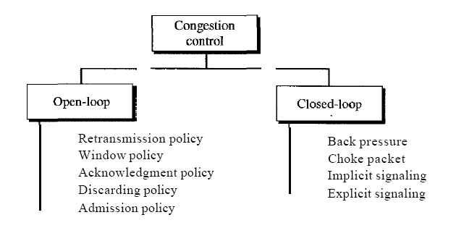
Congestion Control Categories

Slide 7
Open-Loop Congestion Control
Here policies are applied to prevent congestion before it happens
Retransmission Policy:
Sometimes unavoidable
Sender feels sent packet is lost: initiates retransmission.
May increase network congestion.
Retransmission policy and timers to be designed to increase efficiency and avoid congestion

Slide 8
Open-Loop Congestion Control
2. Window Policy:
Type of window at sender side and receiver side.
Selective Repeat window better than Go-Back-N
3. Acknowledgment Policy:
- ACK policy of receiver may also affect congestion

Slide 9
Open-Loop Congestion Control
Rx does not acknowledging every packet may slow down sender.
Rx may send NAK for only lost packets.
Rx may decide to acknowledge N frames together.
ACKs are part of load on network.

Slide 10
Open-Loop Congestion Control
4. Discarding Policy:
A good discarding policy of routers may prevent congestion.
5. Admission Policy:
Can also prevent congestion in virtual network circuits.
Router can deny establishing virtual connection if there is congestion or possibility of congestion over the network.

Slide 11
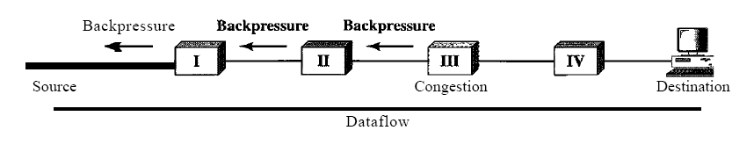
Close-Loop Congestion Control
Close loop congestion control will try to reduce congestion after it happens.
Backpressure

Slide 12
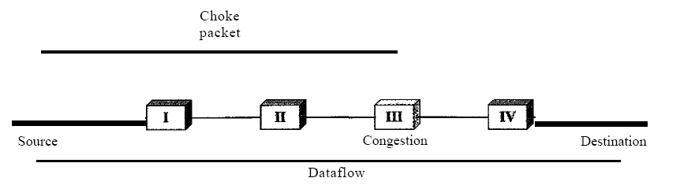
Close-Loop Congestion Control
2. Choke Packet
- Choke packet directly from congested node to source- ICMP message

Slide 13
Close-Loop Congestion Control
3. Implicit Signaling
No communication between congested node or nodes and source.
Source guesses congestion in the network from other symptoms
Example: Packet sent by source but no ACK.
Delay in ACK
NAK

Slide 14
Close-Loop Congestion Control
4. Explicit Signaling
Node that experiences explicitly sends signal to source or destination.
Choke packet separate packet is sent.
Explicit signaling: congestion related signal is included in data packet.

Slide 15
Close-Loop Congestion Control
Backward Signaling
Bit set in packet moving in direction opposite to the congestion.
Bit warns source about congestion signaling it to slow down.

Slide 16
Close-Loop Congestion Control
Forward Signaling
Bit set in packet moving in direction of congestion.
Bit warns destination about congestion.
Rx can thus slow down ACK to alleviate congestion

